Slide 1
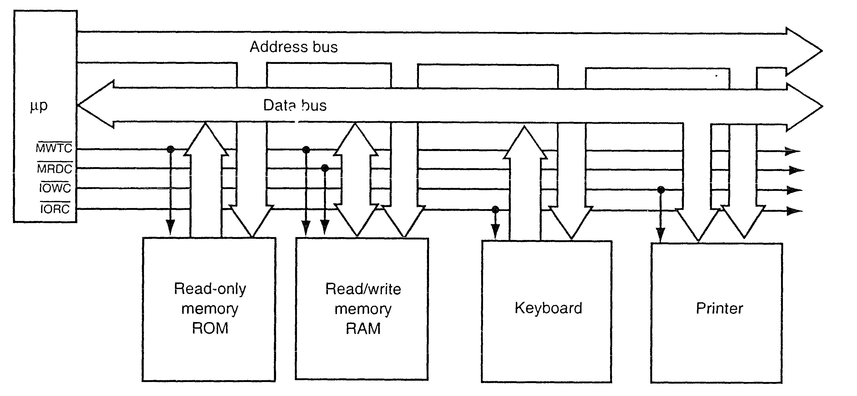
Figure 1-8: Block diagram of a computer system showing the address, data and control bus structure

Slide 2
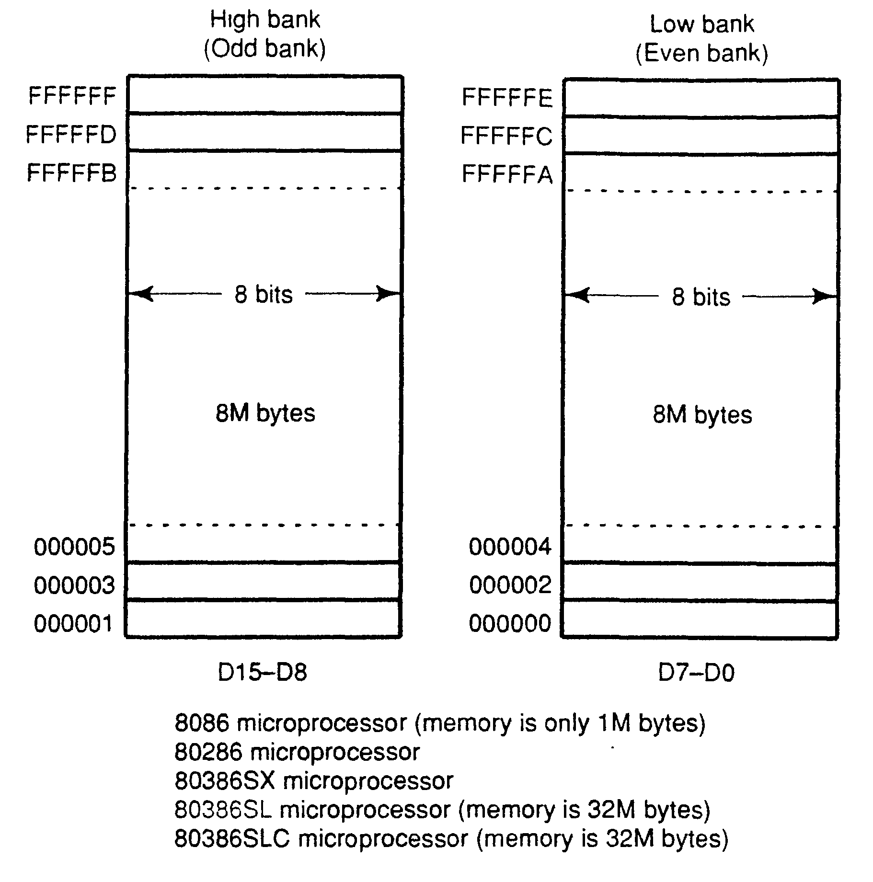
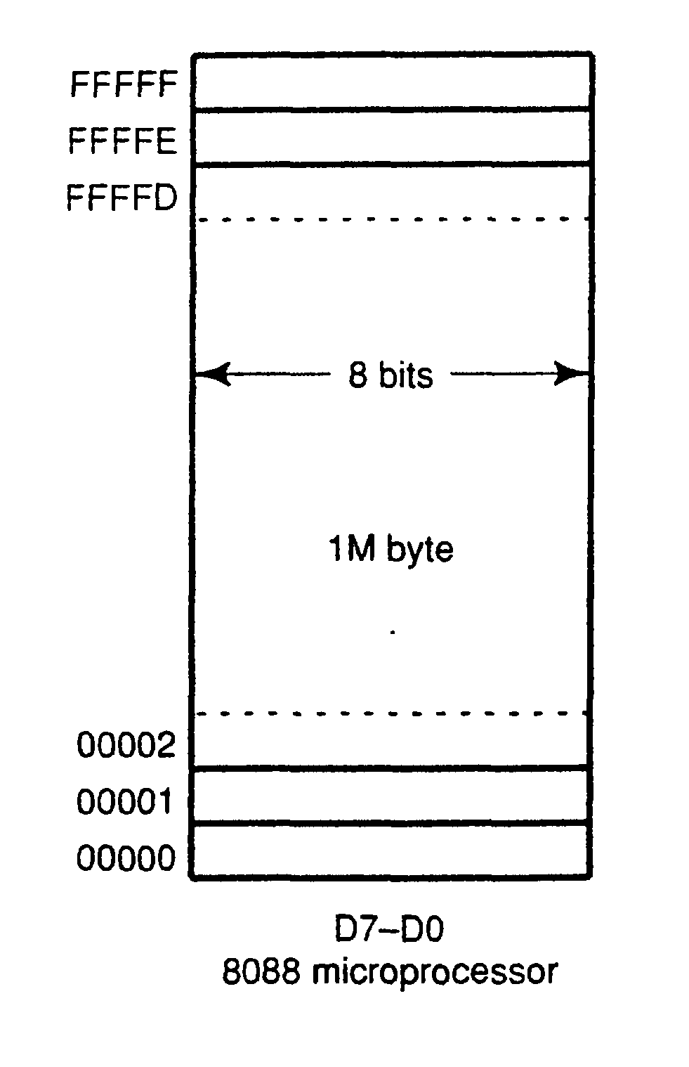
Figure 1-9: Physical memory system of the 8086 through Pentium Pro microprocessor

Slide 3
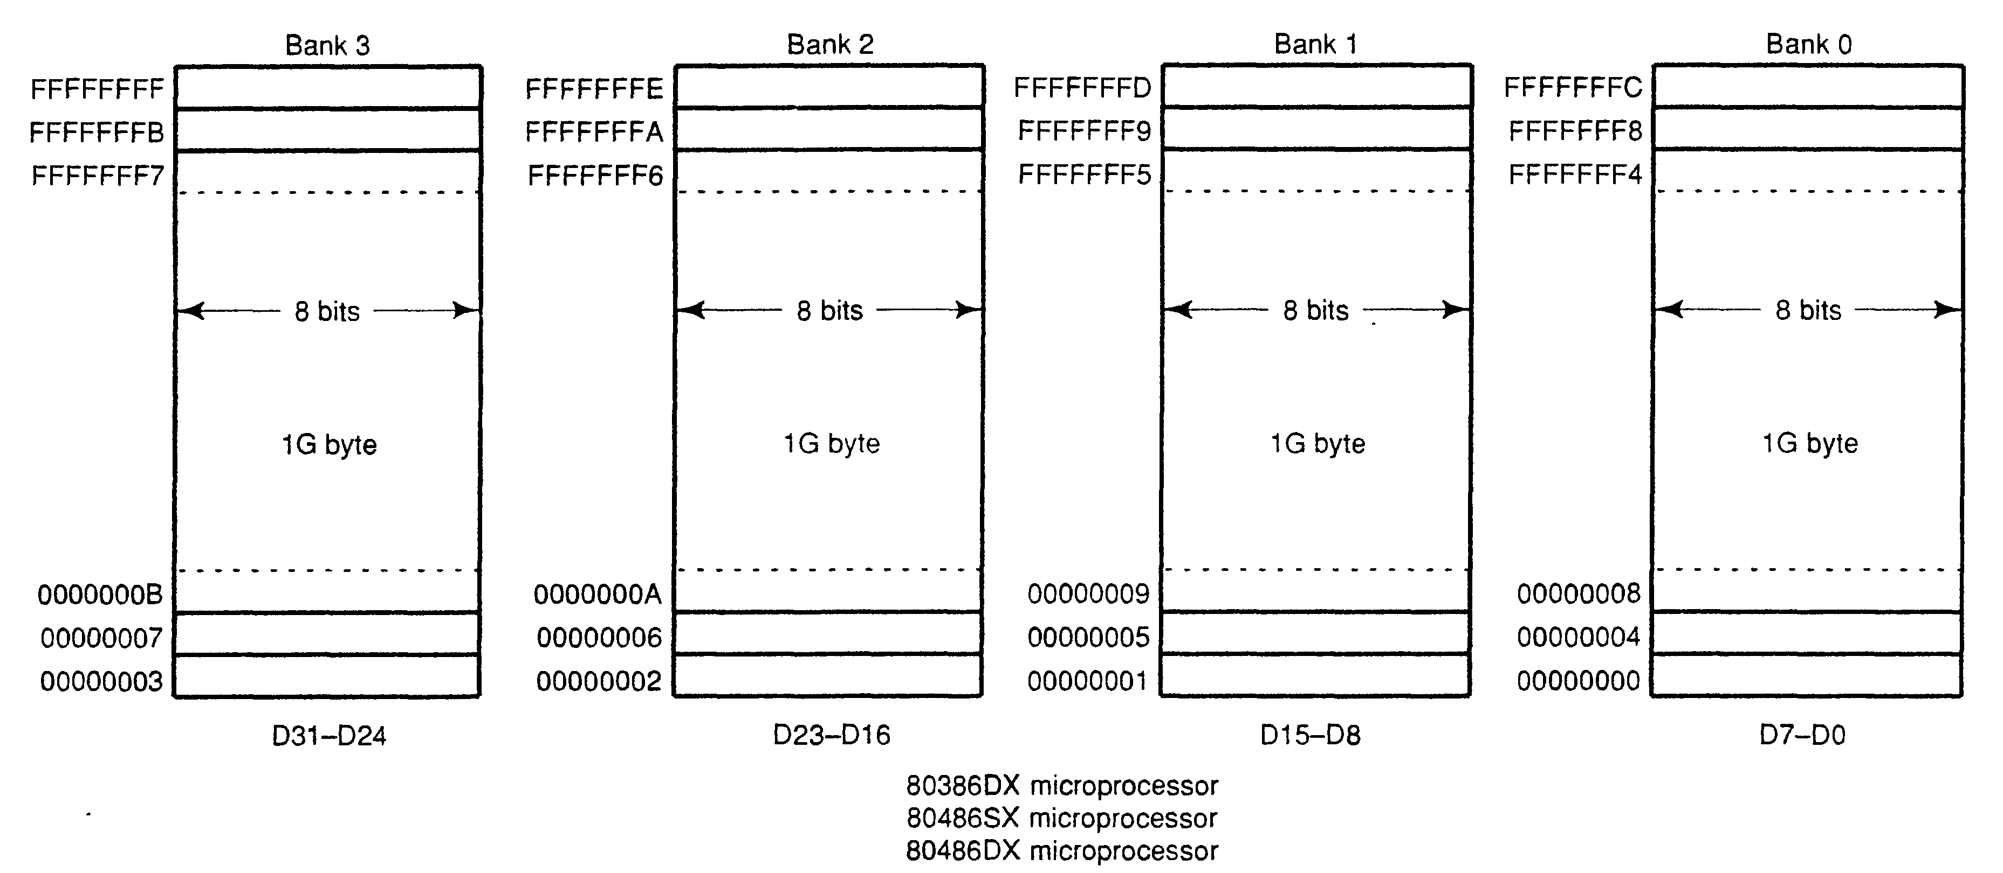
Figure 1-9: Physical memory system of the 8086 through Pentium Pro microprocessor

Slide 4
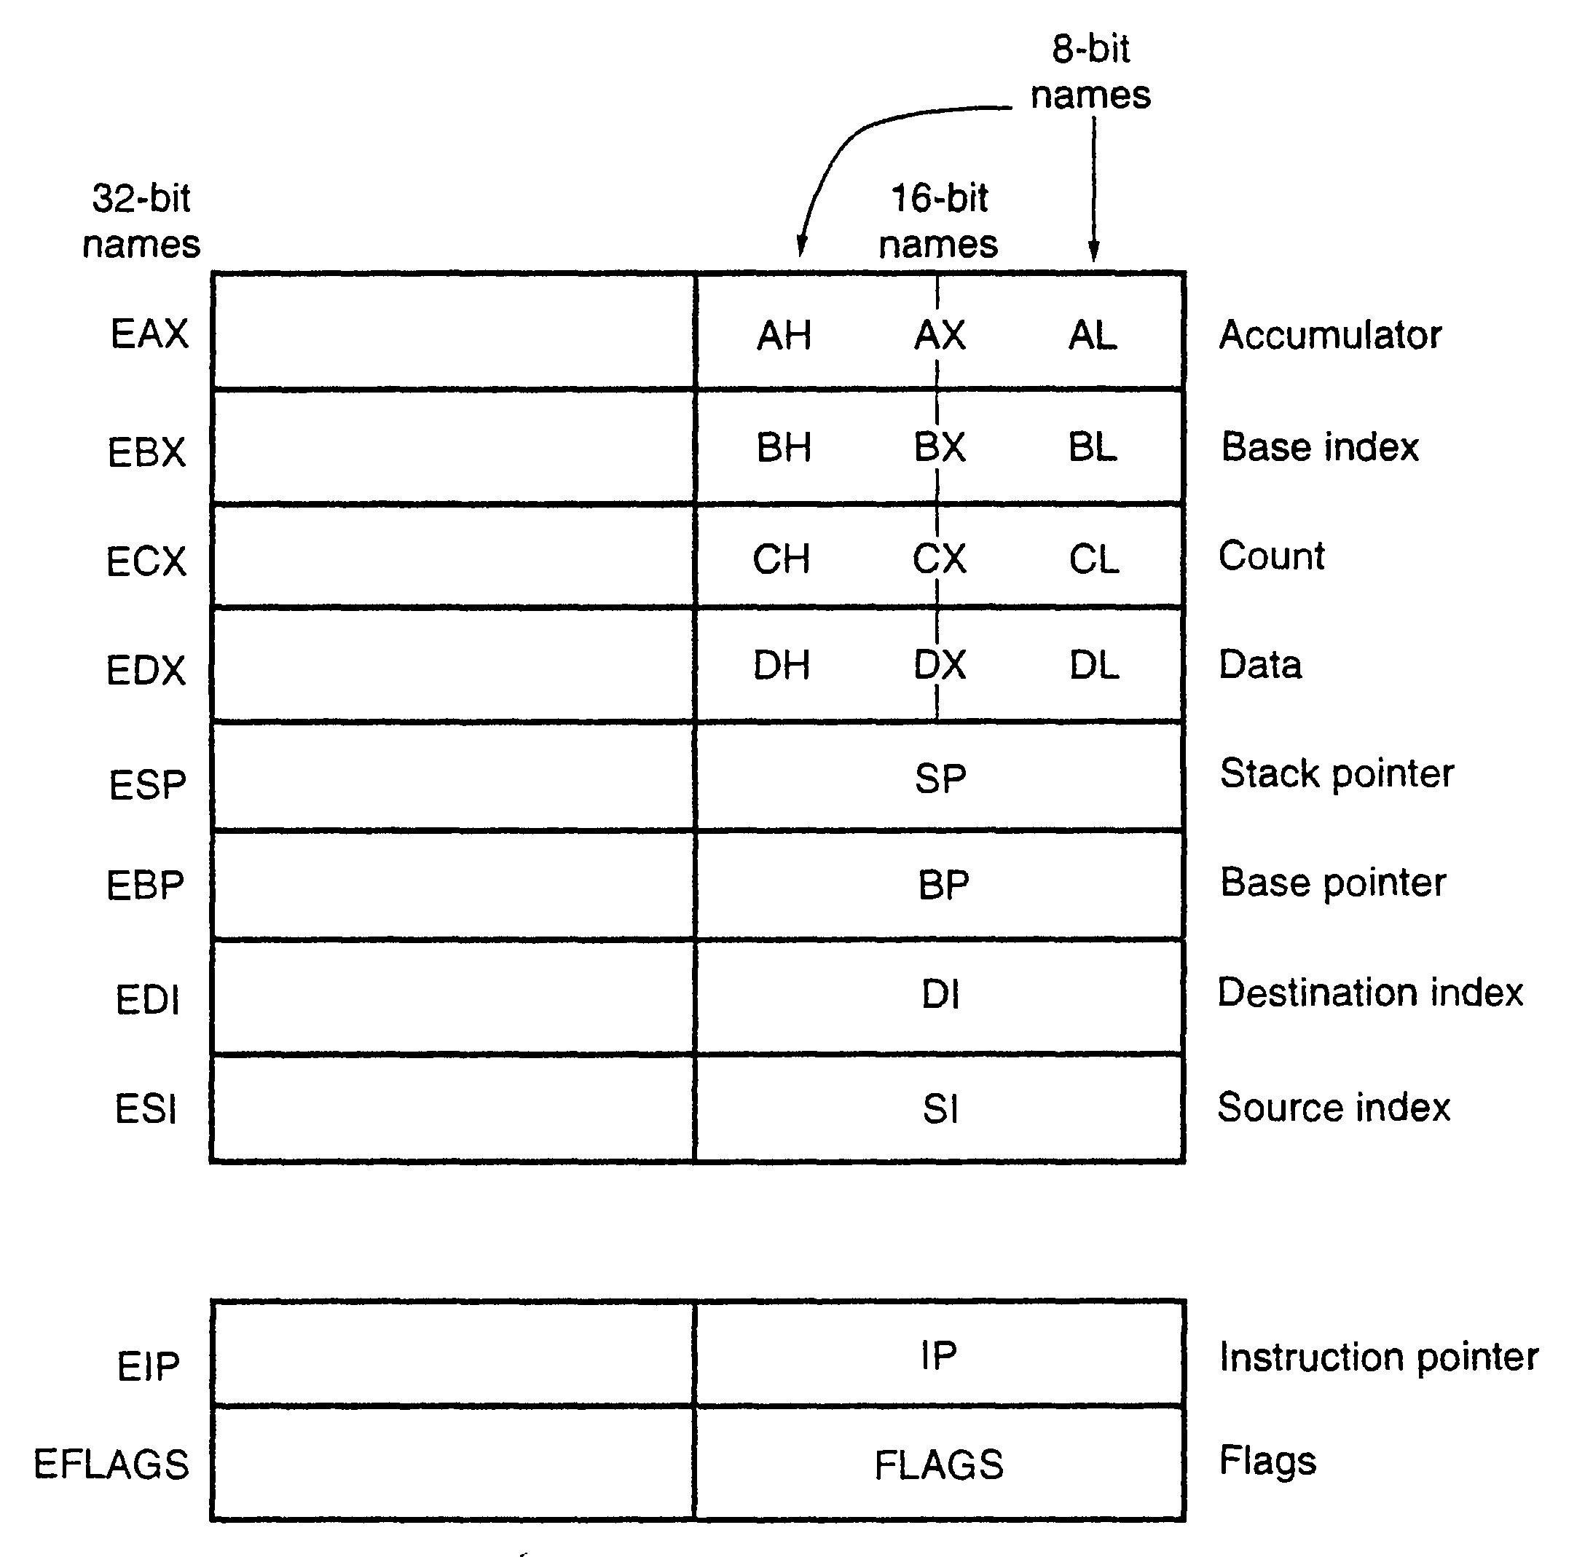

Slide 5
